Slide 1

Department of Information Technology
NBA Accredited A.P. Shah Institute of Technology G.B.Road,Kasarvadavli, Thane(W), Mumbai-400615 UNIVERSITY OF MUMBAI Academic Year 2021-2022

Slide 2
A Project Presentation on Facial Emotion Recognition Submitted in partial fulfillment of the degree of Bachelor of Engineering(Sem-6)
in INFORMATION TECHNOLOGY By Akshay Bura(19104041) Sourav Joshi(19104068) Sakshi Deshpande(19104002) Under the Guidance of Mr. Vishal Badgujar

Slide 3
1.Project Conception and Initiation

Slide 4
1.1 Objectives :
To find out the improvement opportunities for the existing facial expression recognition system.
To achieve efficiency in Behavioural Testing.
To build a tool which help in Marketing.
To study emotions of person in different situation.
To help psychologist, police.

Slide 5
1.2 Literature Review
Sr No. | Author | Paper Title | Findings
1. | Neha Jain, Shishir Kumar, Amit Kumar, Pourya Shamsolmoali, Masoumeh Zareapoor. | Hybrid Deep Neural networks for Face Emotion Recognition. | A novel Hybrid CNN-RNN model for Facial Emotion Recognition.
2. | Ninad Mehendale | Facial emotion recognition using convolutional neural networks (FERC) | The FERC is based on two-part convolutional neural network (CNN).
3. | Tawsin Uddin Ahmed, Sazzad Hossain, Mohammad Shahadat Hossain, Karl Andersson | Facial Expression Recognition using Convolutional Neural Network with Data Augmentation | The objective of this research is to develop a facial expression recognition system based on convolutional neural network with data augmentation

Slide 6
1.3 Problem Definition :
Facial emotion detection is an easy task for humans but not for computers.
To achieve this we have used certain Machine Learning algorithms.
We can use this as evidence to uncover whether an individual is speaking truth or not.

Slide 7
1.4 Scope :
People with mental disorder
Behavioural Testing
Gaming Industry

Slide 8
1.5 Technology stack :
Python - High end programming language
Tensorflow - Training of deep neural network
OpenCV - Image Processing
Jupyter / Colab Notebook - Data science tasks

Slide 9
2. Project Design

Slide 10
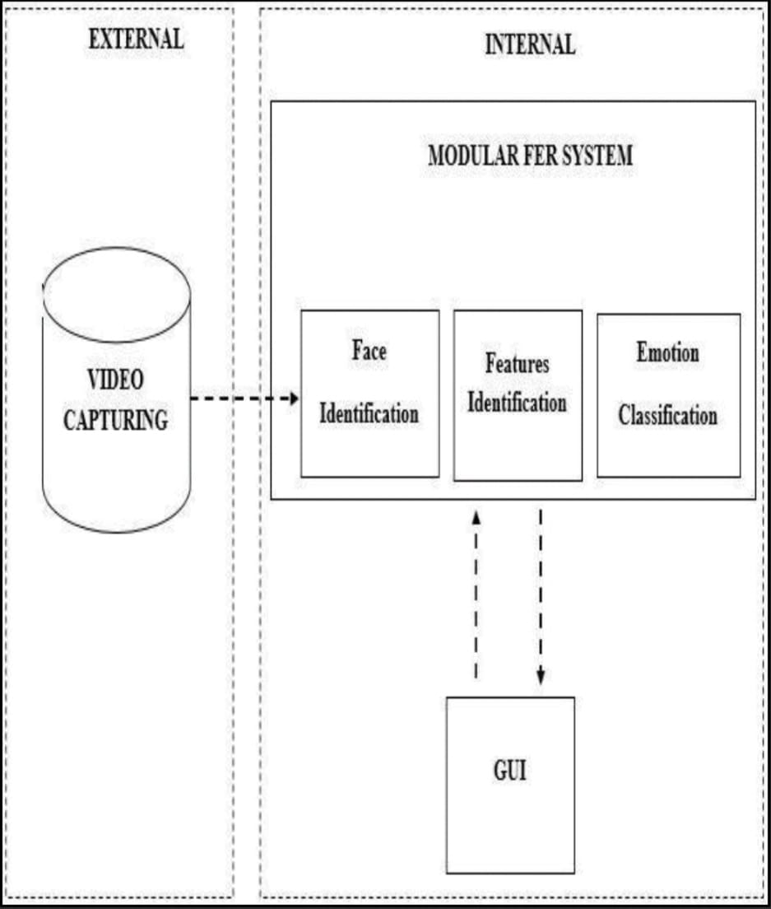
2.1 Proposed System :

Slide 11
2.2 Design(Flow Of Modules) :

Slide 12
3. Implementation

Slide 13
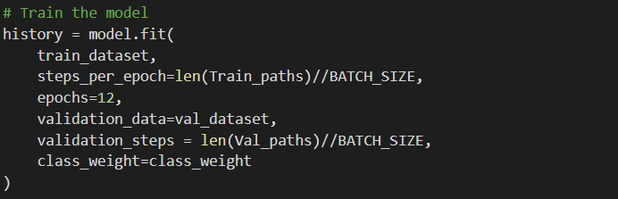
It will train the model using dataset
Accuracy = 0.62

Slide 14
4. Result

Slide 15
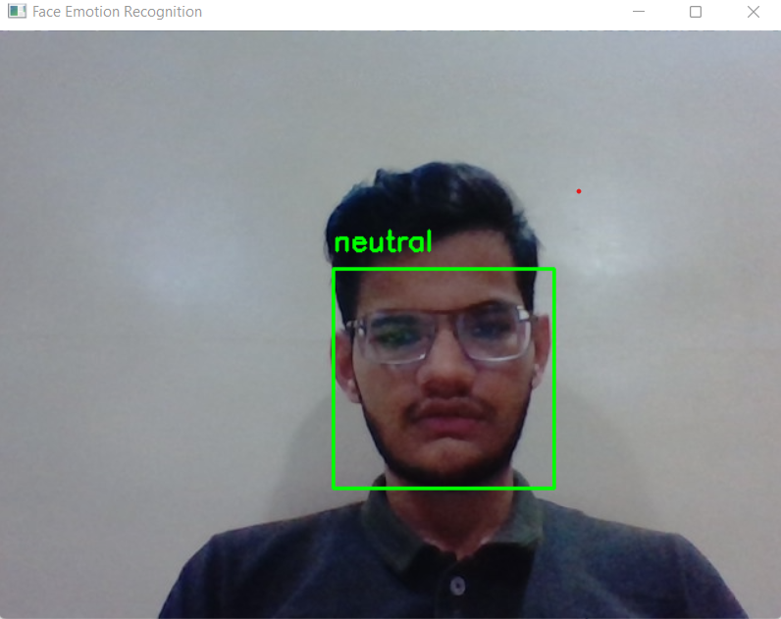

Slide 16
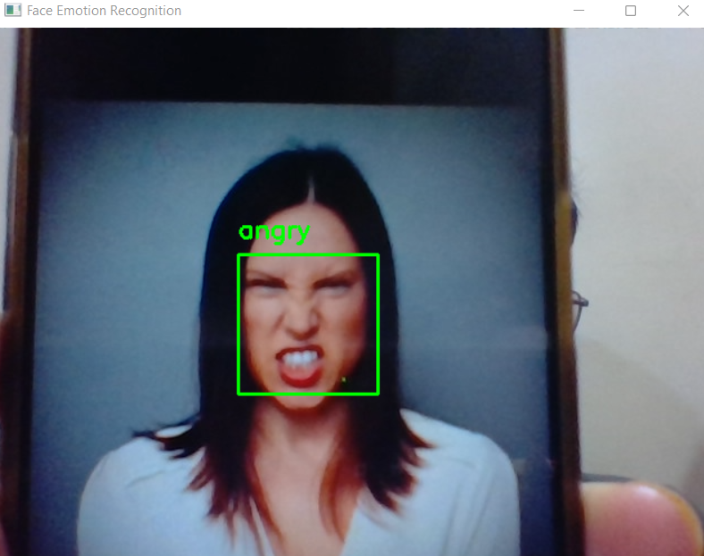

Slide 17
5. Conclusion and Future Scope

Slide 18
Conclusion :
We have created an ML-Based model which can guess the emotions(such as Happy, Sad, Angry, etc) of the user.
Our model uses the advantages of Neural Networks.
This could be the starting step, for many of the emotion-based applications such as lie detector and also mood-based learning for students, etc.
The proposed model has achieved a commendable result.

Slide 19
Future Scope :
Adding more data in each class in order to get more accurate results.
Saving data with name of person.
In the future, we can try to develop the model more efficiently so that a more standard facial expression recognition system can be delivered.

Slide 20
References :
https://www.researchgate.net/figure/Sequence-diagram-of-face-recognition-system_fig4_321166919
https://towardsdatascience.com/emotion-detection-a-machine-learning-project-f7431f652b1f
https://paperswithcode.com/task/facial-expression-recognition

Slide 21
Thank You

